Slide 1
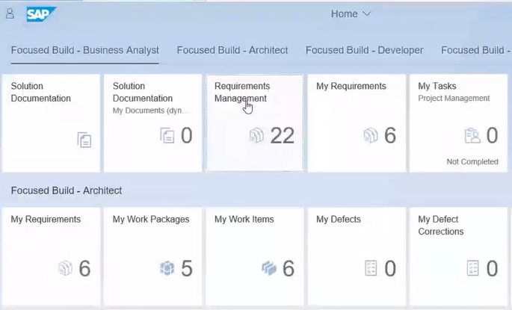
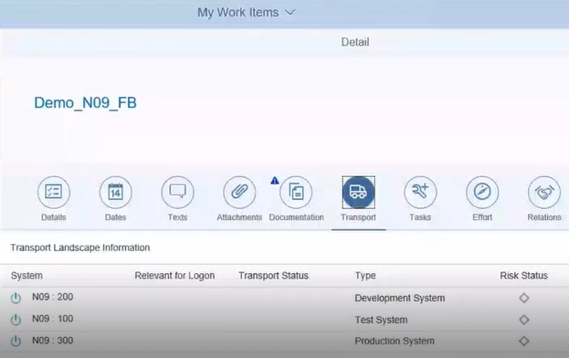
Why our clients use DevOps & what they want
Automated delivery
More frequent and low touch deployments
DevOps & SAP
Best in Class delivery
Adopt best practices and embedded them in delivery
Agile delivery
rapid, frequent & iterative delivery
Maximise return on current IT – Utilise current software & tools effectively
Responsive to the business
shortcuts to extreme productivity
Design thinking
Discover, explore, design & deploy
Common delivery method
a consistent open approach for development & delivery
Effective use of resources
Maximise use of tools & effective use of team members time
“Delivering solutions today to secure IT asset health, speed delivery & reduce technical debt”

Slide 2
DevOps – Overview of some of the key concepts
Principles
Strategy
Governance & Organization
Business ‘product’ focus
Higher Automation
Cross skilled Teams
Resilient & loosely coupled
Fast updates & deployments
Drive flexibility & innovation
Core solution & methodology
Domains of delivery (i.e. cloud, heritage on-premise..)
Architectural approach
Design, Security & resilience
System specific approaches
Overall governance
Architectural governance
Approved design patterns
Team size/focus
Commercial considerations
Low or Zero touch, automated
Tool Chains
Products
Delivery
Scope of tool chain (Design, build, test, deploy etc)
Recommended tools
Product specific solutions
Co-ordination/orchestration
Management & Control
Existing tools in a Company
Best of breed & frequently used options (Agile Dev)
Application specific (i.e. SAP)
HCL’s Accelerate, OneTest…
Pragmatic options(Excel, MSPrj
Pilot Solutions/areas
Establishing delivery
Experience team “pairing”
Enabling adoption
Focus on differentiators
Driving Innovation

Slide 3




DevOps – High Level Approach
Plan & Setup
Development & Test
Deliver & Change
Monitor & Operate
Focusing on rapid product delivery through the adoption of agile, lean practices via a business led and benefit oriented approach. All skills in one collaborative team.
Agile Development & Continuous Integration (CI) within an agile and design thinking lead approach, utilizing automation and dev/test tools to minimize interventions
Continuous deployment with full tools to ease deployment and release management
Manage monitoring, alerting and operation for ongoing resilience with effective feedback and reviews to support on-going improvement & innovation
How to setup run and operate agile and/or DevOps delivery
How to develop rapidly & improve efficiencies retaining quality & control
How manage change & deployments on a more frequent basis
How to manage on-going operations with effective feedback & improvement

Slide 4
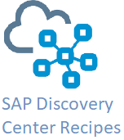
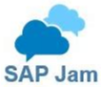
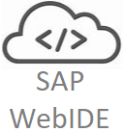
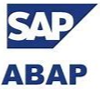

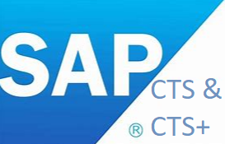

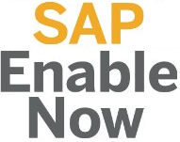

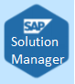




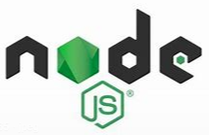


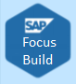
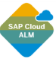



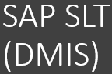
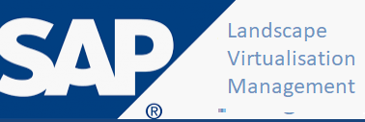






DevOps – SAP Centric Toolchain Example SAP solutions and some common third party items
Development toolchain
Plan &
Setup
Continuous Integration
Continuous Testing
Continuous Deploy
Monitor & Operate
Improve
/Retire
DevOps
Planner
Ideas & Design
Develop/Build
Unit Test
Transport /
Deploy to QA
Validate / Verify
(System, UAT )
& Regression
Delivery &
Change
Management
Transport /
Deploy to Prod
Logging
Monitoring
Dashboards
& insights
Velocity
SCP
DevOps
Planner
HCL Accelerate
Transport
Expresso
HCL Lucy
Agile ALM /
Product Dev
QA
Code, Config
& Rule
Management
Package & Multi
Target Apps
Test
Automation
Performance
Stress, Vol
Security Tests
Build & Refresh
Release
Planning &
Management
Operation
Landscape
Management
AIOPs
SolMan
IT Calendar
SAP FocusRun
ALM, Tosca..
HCL
Launch
Splunk,
DynaTrace
LoadRunner
Business Services & Technical Services
Problem and Incident Management
Solution Documentation and Code Repositories
Other Supporting Services
Continuous Security, Continuous Knowledge Transfer, Environment Management

Slide 5
DevOps – Wider Toolchain
Functionality | DevOps with existing toolset | DevOps - SAP On-Prem | DevOps - SAP On Cloud | DevOps - NON-SAP
DevOps: Governance/Orchestration | Manual (Excel, PPT, MS-Proj) | HCL Accelerate | HCL Accelerate | HCL Accelerate, Jenkins/Snow/Remedy
Plan: Planning | Manual (Excel, PPT, MS-Proj) | Solution Manager, FocusBuild, Atlassian Jira | Solution Manager, FocusBuild, Atlassian Jira | Atlassian Jira
Code: Source Code Management | ECC - Abap for Conflict management across Dev systems (multi-track Envs) | abapGit | abapGit | GitHub, BitBucket
Code: Code Quality | Coding standards, peer reviews, check lists | SAP ATC, SAP Code Inspector, SonarQube, HANASmart/HANARun | SAP ATC, SAP Code Inspector, SonarQube | AppScan, SonarQube
Code: Code Security | Coding standards, peer reviews, check lists | SAP ATC, SAP Code Inspector (* can extend code checker with special checks/logic which HCL has completed) | SAP ATC, SAP Code Inspector | AppScan, Fortify
Build Design | Design templates (in Powerpoint) | SAP Fiori Design Stencils are available for Sketch, Axure RP & Adobe XD platforms | SAP Fiori Design Stencils are available for Sketch, Axure RP & Adobe XD platforms | Build.me, Justinmind
Build: Build | Eclipse, Apache JMS, SAP Native | Meven, NW, Eclipse, Apache JMS, SAP Native | Meven, NW, Eclipse, Apache JMS, SAP Native | VSTS, Meven, Eclipse, Apache JMS
Test: Unit Test | ABAP Unit, SAP Native | ABAP Unit (Aunit), Catt/eCatt (SAP CBT) | ABAP Unit (for side by side dev) | Junit, nUnit
Test: Functional | SAP Native, UFT | SAP CBTA, ALM, OneTest, SAP TAO | SAP CBTA, ALM, OneTest, SAP TAO | OneTest, Selenium, Tosca, Loadrunner, QuickTest, WorkSoft, HP Service Test
Test: Performance | Coding standards, peer reviews, check lists | OneTest (UI) | OneTest (UI) | DynaTrace, JMeter , LoadRunner, Performance Centre , Rational Performance Tester , Borland Silk Performer, OpenSTA , Compuware QA Load , iControl
Test: Service/API (Middleware testing) | NA | OneTest (API), SAP's PIT | OneTest (API), SAP's PIT | OneTest, Int4's IFTT, Figaf IRT
Mobile Test Automation, Platform/Lab, browser | Browser to emulate mobiles | - | - | pCloudy, Appium
Test: Accessability | NA | SAP's Themes (for use not testing) | SAP's Themes | JAWS / Talkback
Test: Test Data (ETL) | NA | OneTest, TDMS, DataServices, LSMW, LTMC | OneTest, TDMS, DataServices, LSMW, LTMC | OneTest, GenRocket, Gatekeeper, LoadRunner, EPI-USE(for HCM/SF), Infoporter (for HCM/SF)), Winshuttle, Informatica (other ETLs)
Test: Defect Management | SolMan, ALM, Jira | SAP SolMan, ALM, Jira | SAP SolMan, ALM, Jira | ALM, Jira, Silkcentral Test Manager , Testlink , Bugzilla
Service Virtualisation | NA | - | - | DevTest, WireMock
Integration/Release: Repository | NA | NWDS, NWDI, Nexus | Nexus | Nexus
Integration/Release: Continuous Integration | NA | SAP CI/CD on SCP, Jenkins | SAP CI/CD on SCP, Jenkins | Jenkins
Integration/Release: Continuous Deployment | Transport Manager | HCL Launch, Transport Manager | HCL Launch, Transport Manager | HCL Launch, Jenkins
Integration/Release: Orchestration | NA | Solution Manager, ChaRM, Jenkins | Solution Manager, ChaRM, Jenkins | Jenkins, HCL Launch
Integration/Release: Rollback Automation | NA | HCL Launch | HCL Launch | HCL Launch
Infrastructure: Container Platform | NA | Docker, Kubernetes | Docker, Kubernetes | Docker, Kubernetes
Environment Provisioning | NA | SAP IT Infrastructure Manager, SAP Native Toolset, Terraform, HCL Launch | SAP IT Infrastructure Manager, SAP Native Toolset, Terraform, HCL Launch | Terraform, Docker, HCL Launch
Environment Monitoring | Solution Manager | Solution Manager, SAP Native tools, AppDynamics | Solution Manager, SAP Native tools, AppDynamics | AppDynamics
Event Monitoring | ServiceNow | ServiceNow | ServiceNow | ServiceNow
Logging | SAP native | SAP native,Splunk | SAP native, Splunk | Splunk

Slide 6
DevOps - Key Concept & Definitions for SAP
Business & Cultural Change
Maximize Value & Increased Collaboration
PLAN
CODE
BUILD
TEST
TRANS PORT
DEPLOY
OPS
DevOps is a change in delivery culture, focusing on rapid product delivery through the adoption of agile, lean practices via a business led and benefit oriented approach.
A DevOps team will have all required skills and resources within one collaborative team, so the Product owners can influence development & delivery
DevOps
Continuous Deployment
Continuous Testing
----Value----
Continuous Integration
Agile Development
---- Collaboration -----
DevOps will utilise technology to automate and enable speed, flexibility with more rapid deployments and on-going innovation.
Development
Operation
Quality Assurance
How it is different: Agile Dev & Continuous Integration
How to Do it: Scaled Agile Methodology with agile tool set such as Jira, FocusBuild. More loosely coupled solutions, open methods/delivery, Increased code re-use, automated testing, increase code control .inbuild resilience and security. Enabled teams , product/solution focus rather than projects. Iterative delivery with smaller but more frequent releases.
How it is different: Continuous Deployment
How to Do it: Full Life cycle Tools integrated to CI with strong configuration management, improved release management, zero touch release to production, suitable control/approval points. Frequent releases. Visualise releases and deployment status of components & solutions, view of delivery across pipelines & clear release calendar,
How it is different: Continuous Testing
How to Do it: Automation in testing, zero defect pass on
All pre-testing tasks, clean-ups, post-testing tasks, etc. are automated and aligned with the CI cycle
All test cases are automated and achieve near 100% code coverage
Environments are standardized and deployment on QA (and pre-prod) boxes is automated

Slide 7
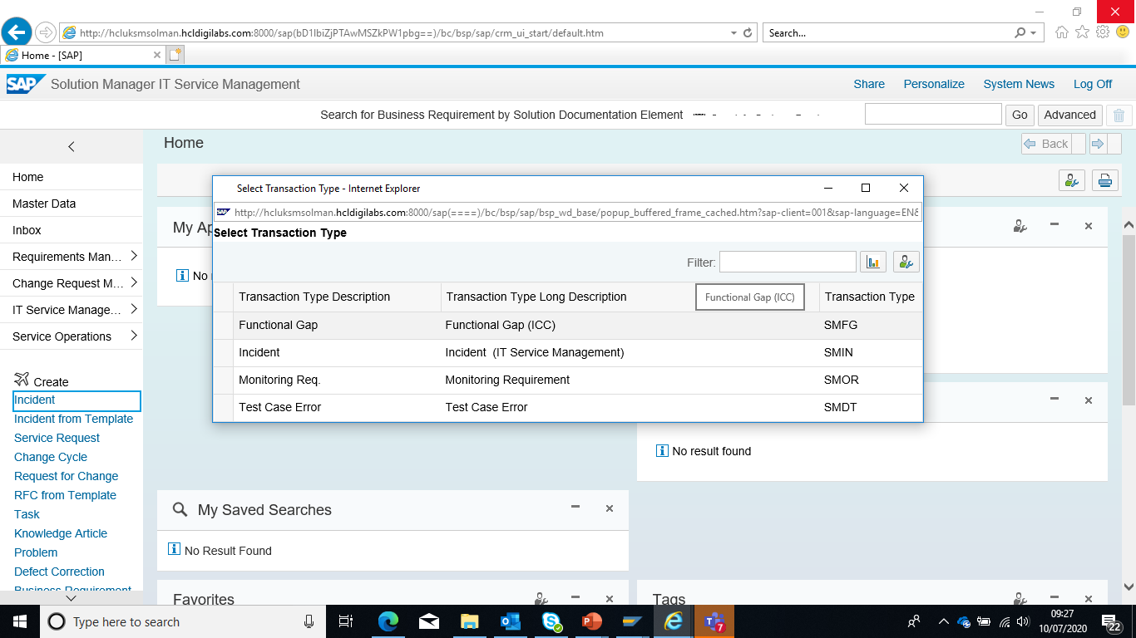
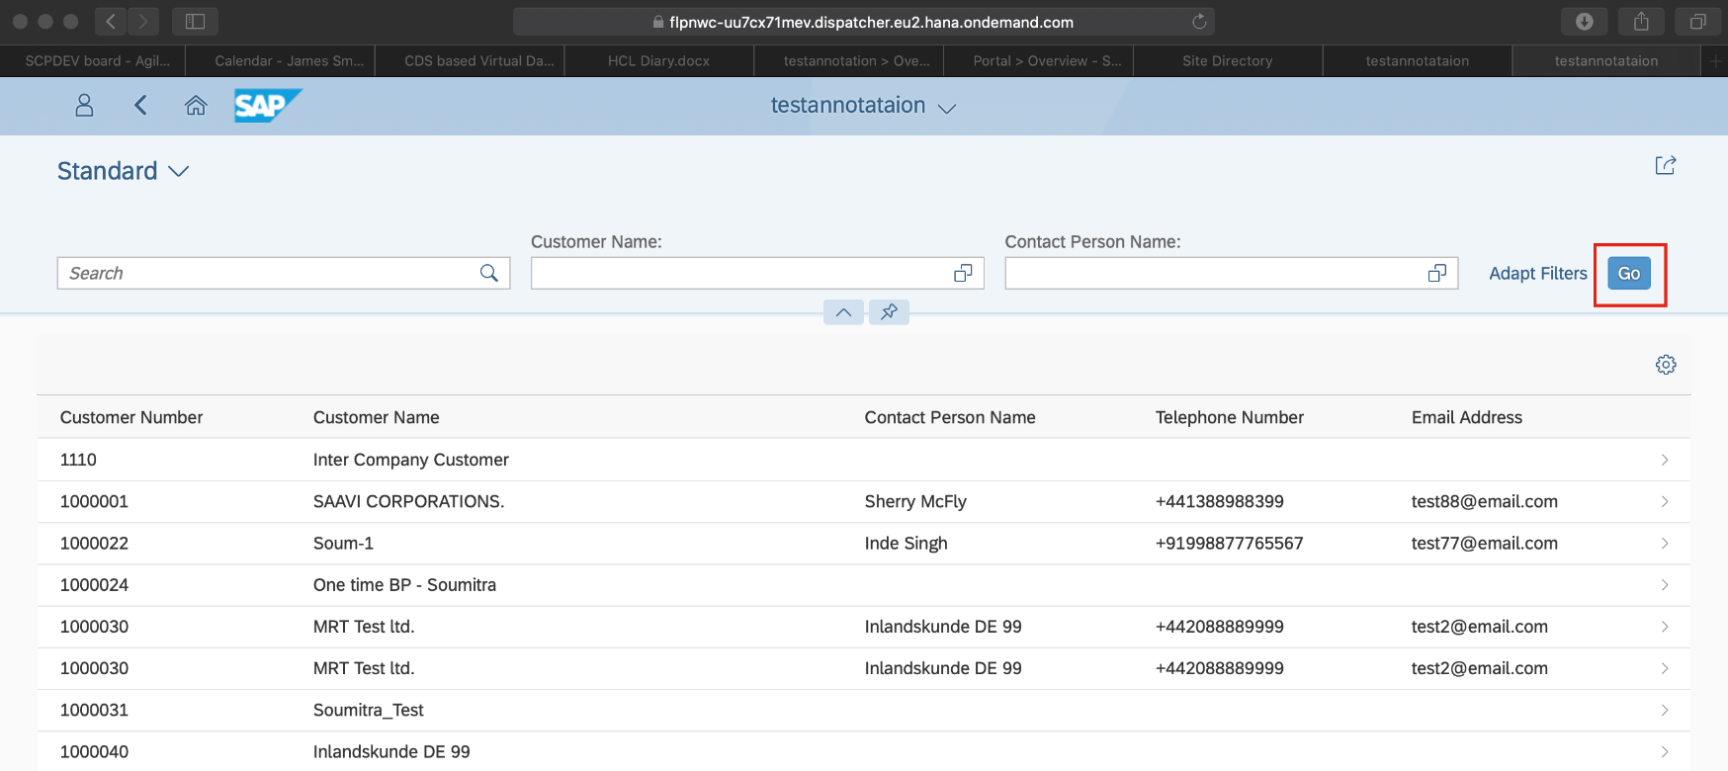
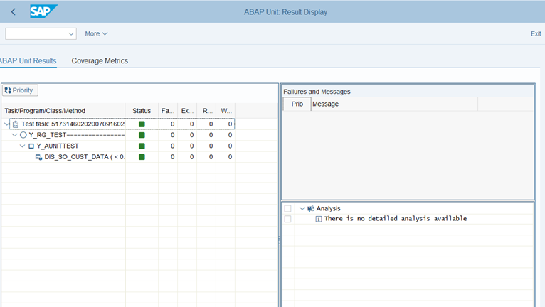
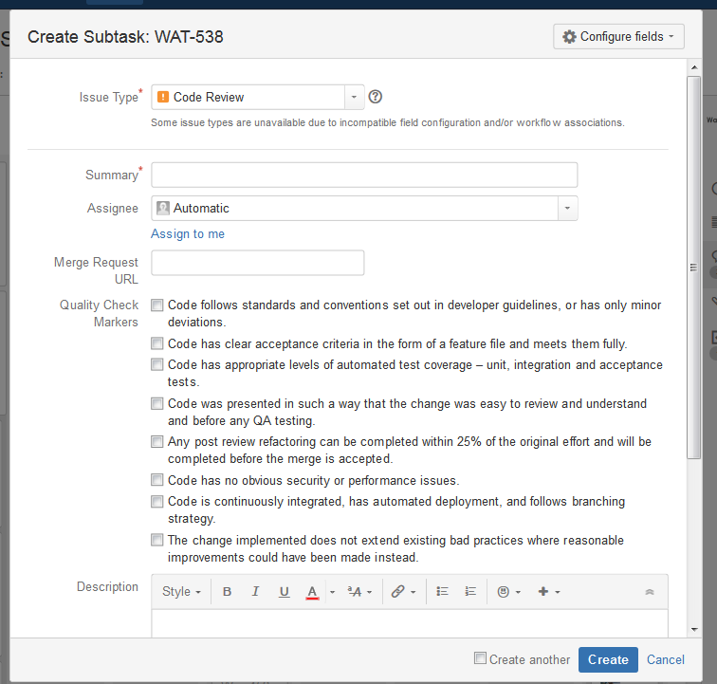
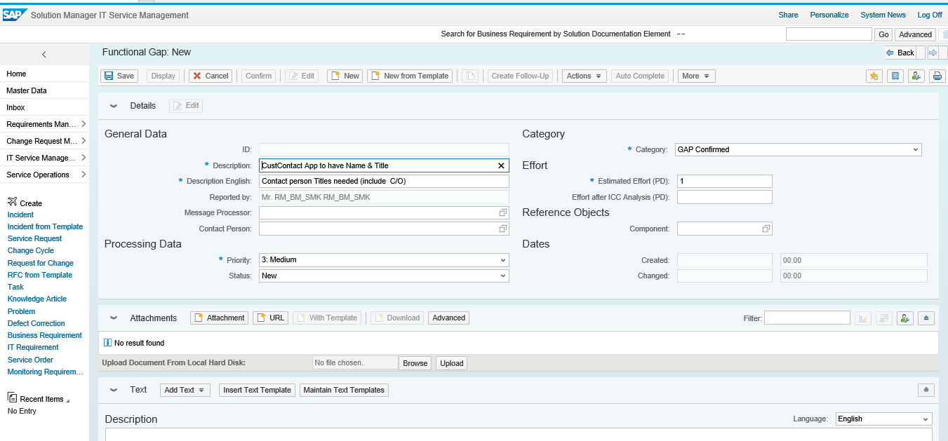
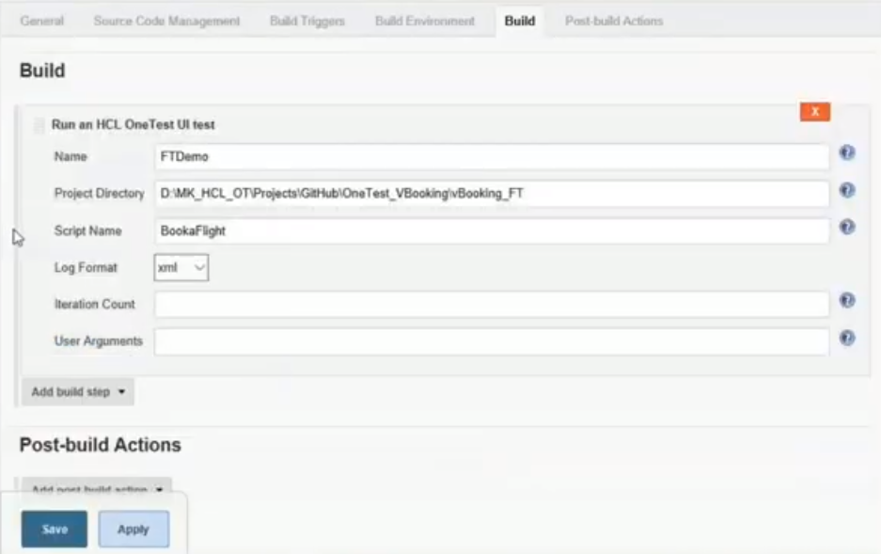
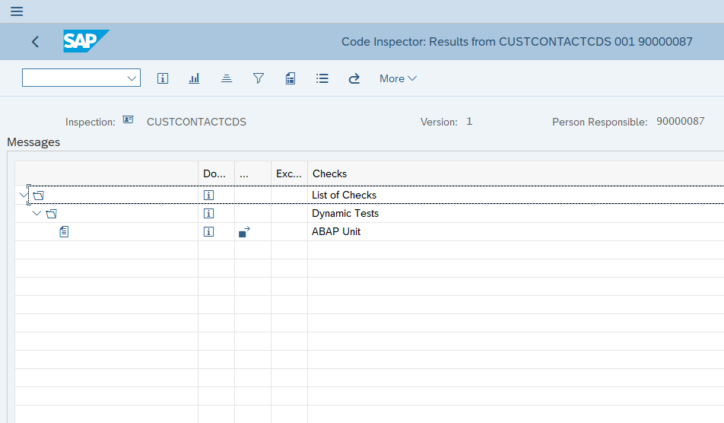
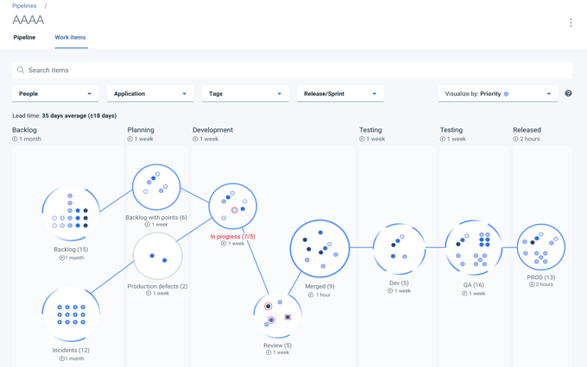
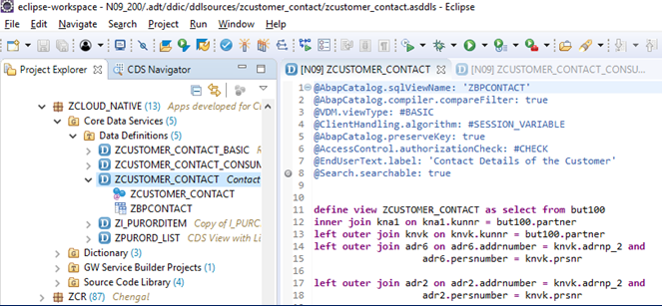
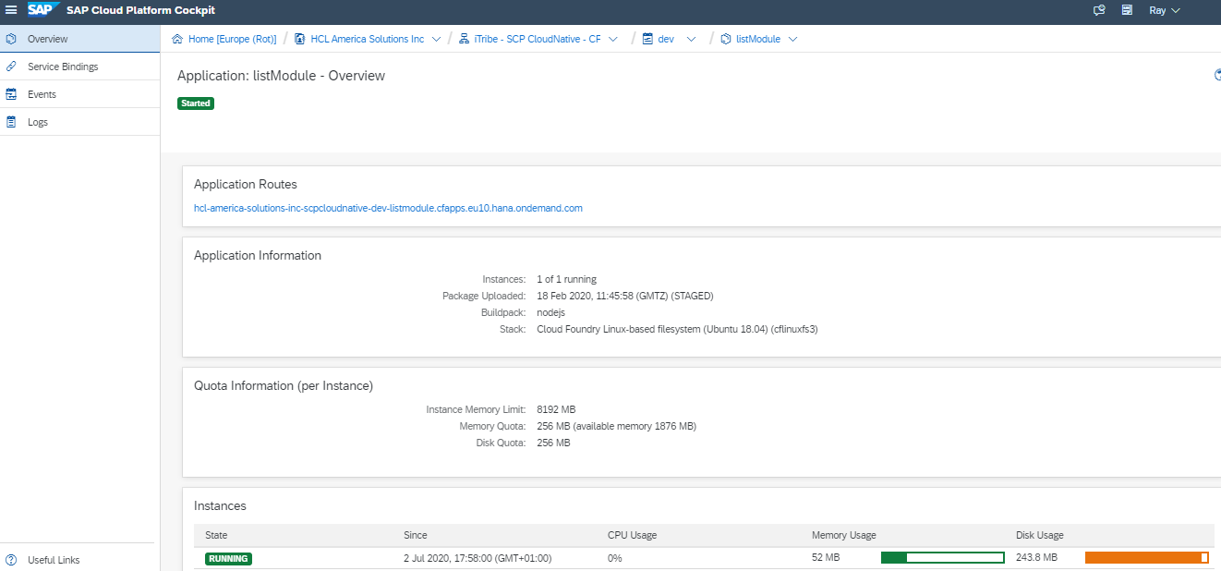
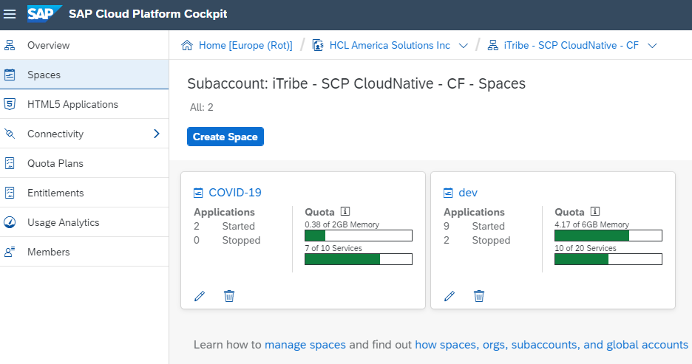
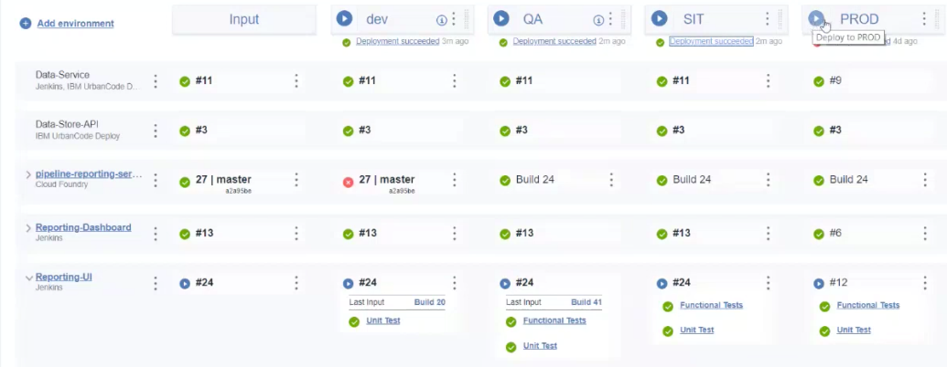
DevOps Demo – Request to Deploy
Scenario 1) Request a change ( SAP Configuration change) – Functional testing by HCL OneTest
2) Cloud Change (WebIDE, GitHub & deploy via Jenkins/Snow ) – Overview control by HCL Accelerate
Core SAP change
1. Raise Change
SolMan/FocusBuild – Request Development
2 App & Config
SCP App & ERP – Show the Config change & use in an App
3. Unit & Functional Test
Aunit test & HCL OneTest– Technical and Functional Tests
4. QA
SAP Code check & Jira QA step – SAP Code inspection (SCI)
Hyrbid change
5. Hybrid / Cloud change
HCL Accelerate Visibility of the change and release
6. Cloud/App Change
WebIDE/Github – new code branch and change
7. Deployment
HCL Accelerate, SNOW and Jenkins– Review & approve
8. Check deployment
HCL Deploy – View versions and deployment

Slide 8
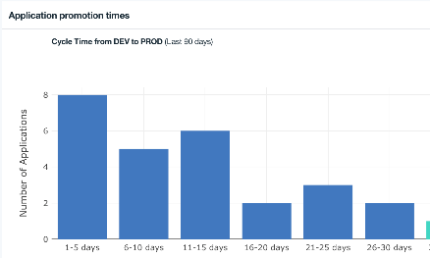
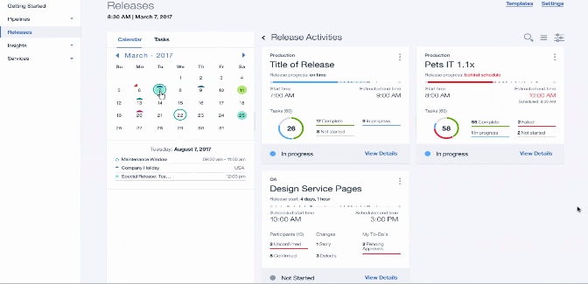
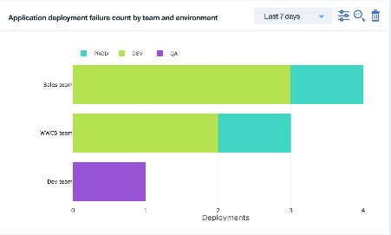
DevOps – Key Teams merging to now delivery DevOps
Business Leaders
Release Teams
Realize the value of hidden continuous delivery data by making it visible and actionable. Focus on requirements, benefits via continuous improvement
Move to more frequent releases with light-weight & automated release management
DevOps Analytics
Automated Release
Development Teams
Operational Teams
Pipeline
Aggregation
A single view for all of the team’s Pipelines. Business led teams (iTribes/Guilds) pipelines shown across all teams from Development to Production
Go beyond traditional Agile views to provide end-to-end value stream transparency & automation
Visual
Management

Slide 9
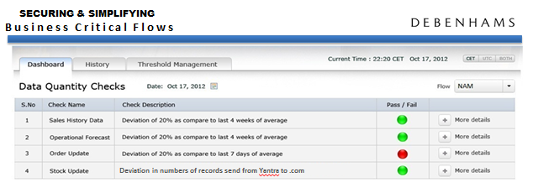
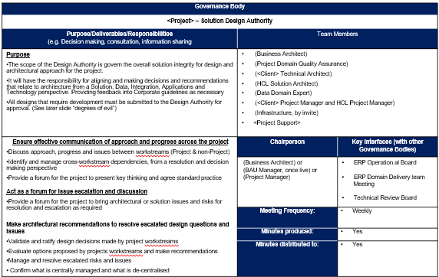
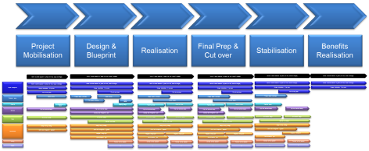
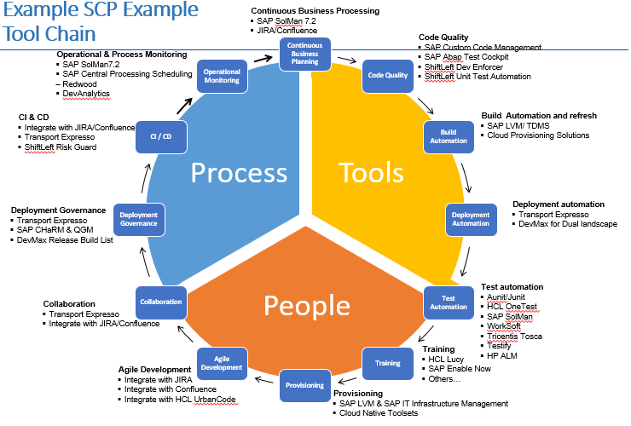
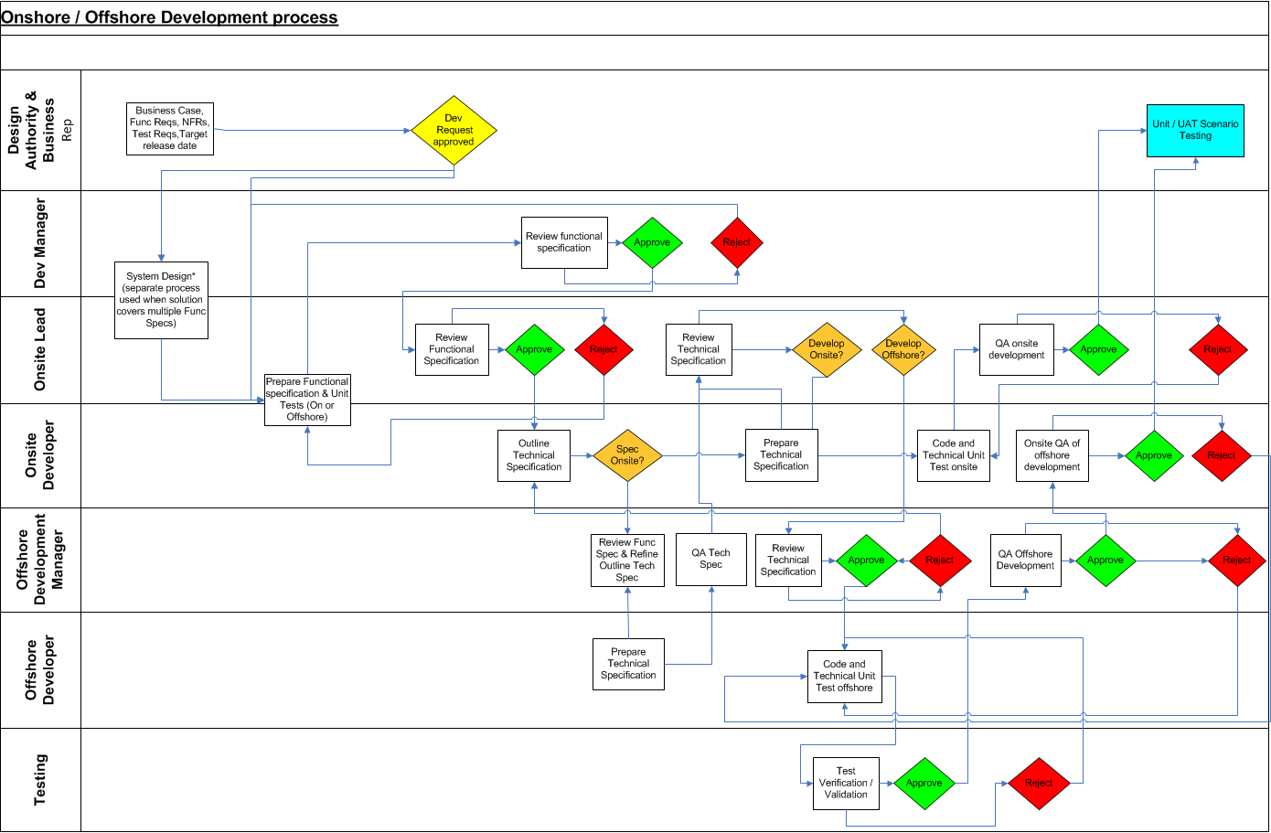
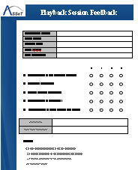
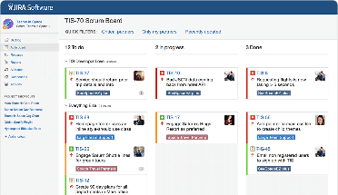
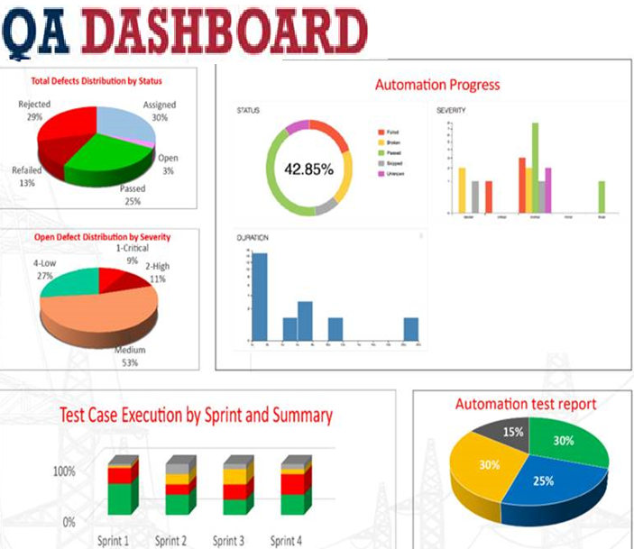
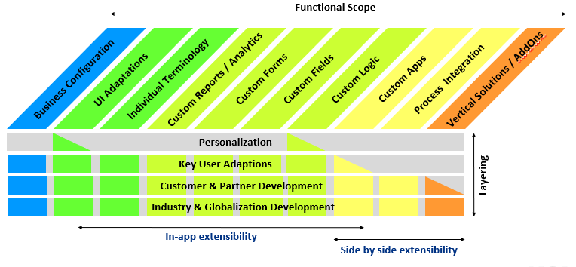
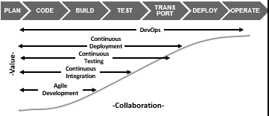
Governance
Standards, Policies,
Naming Conventions..
Delivery & Governance
Reporting and SLA/KPI Management
HCL myDashboard
Design Authority
Methodology
ToolChain
Methods, Practices
Procedures, QA Checks
Automation
Quality Assurance
Best Practices, Patterns
Delivery
Updates & Improvements

Slide 10
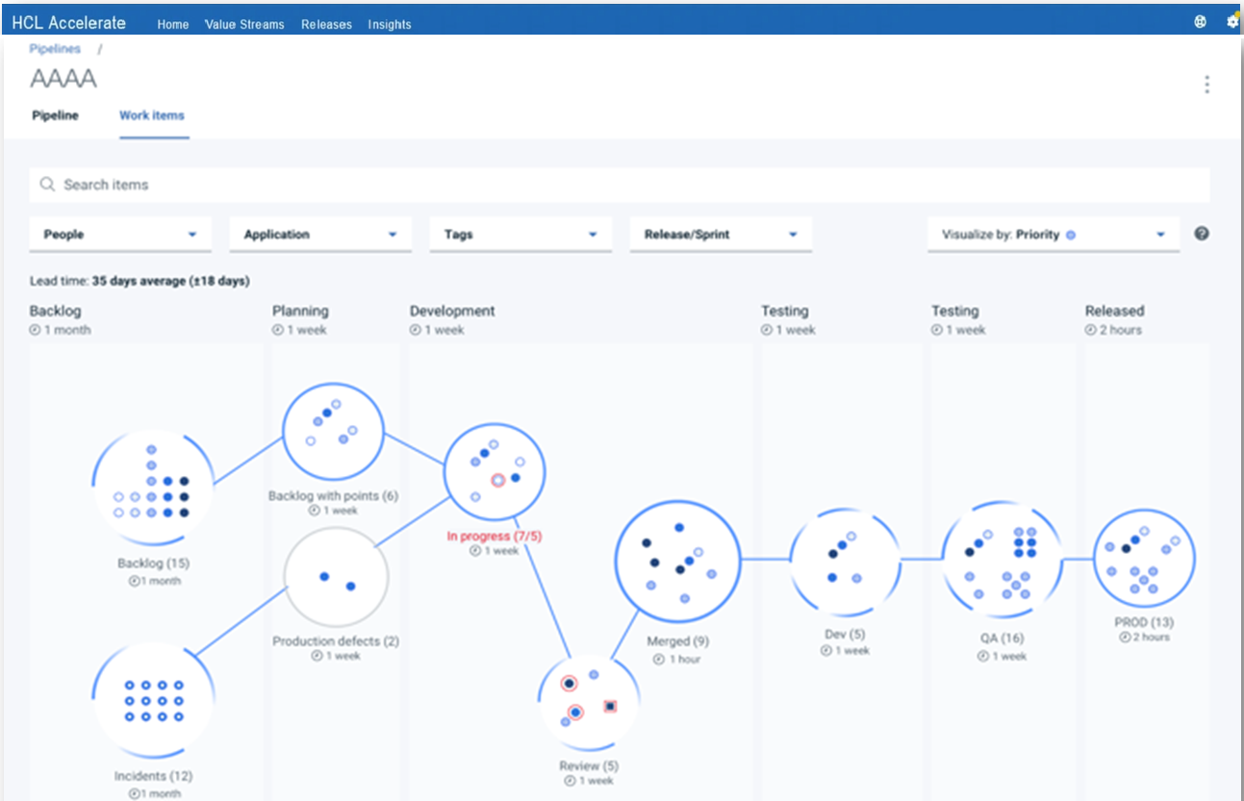
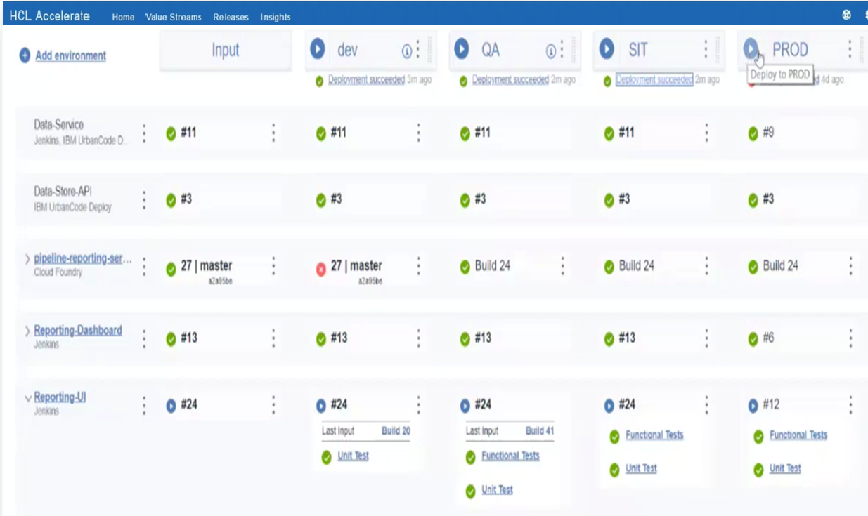
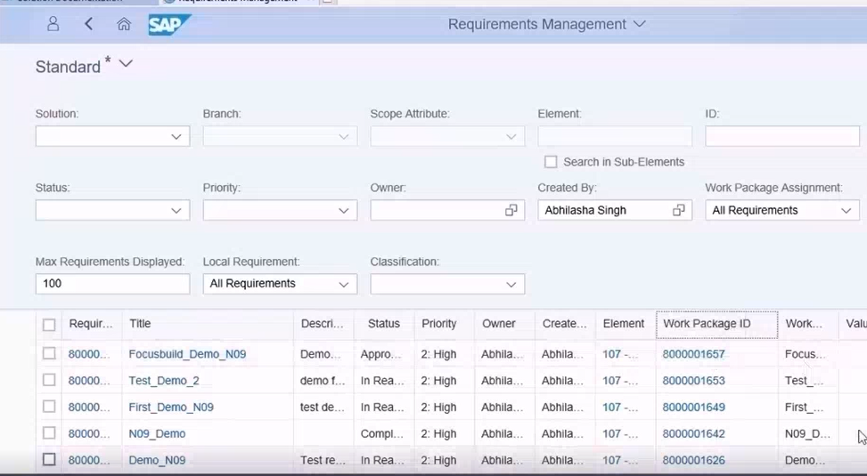
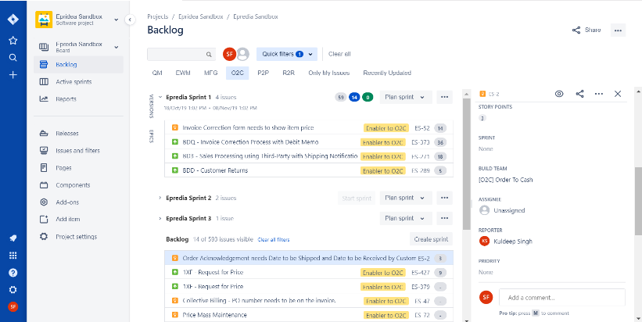
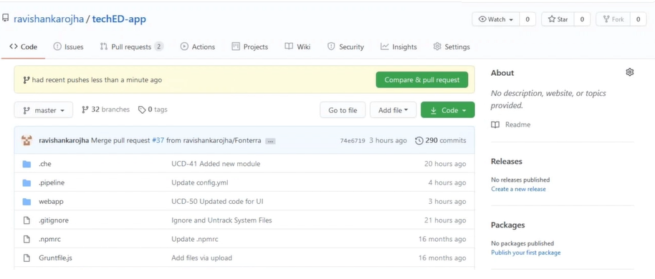
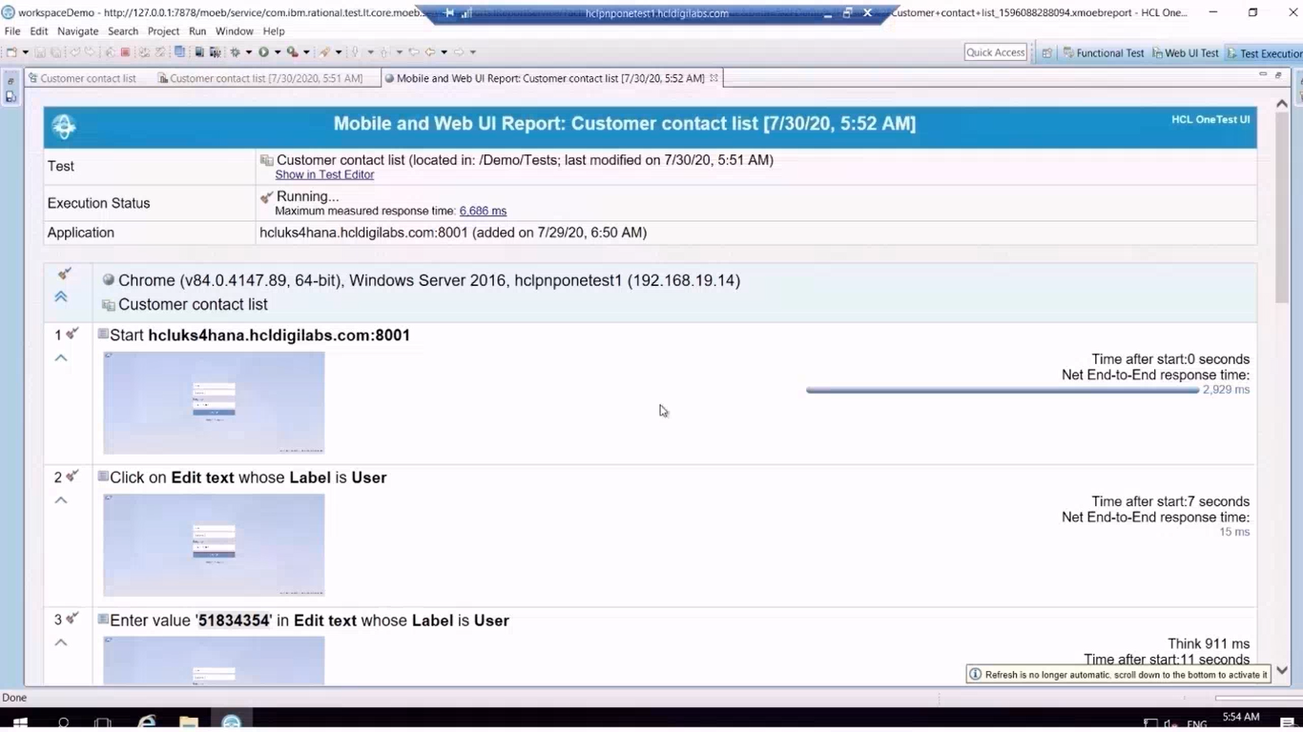
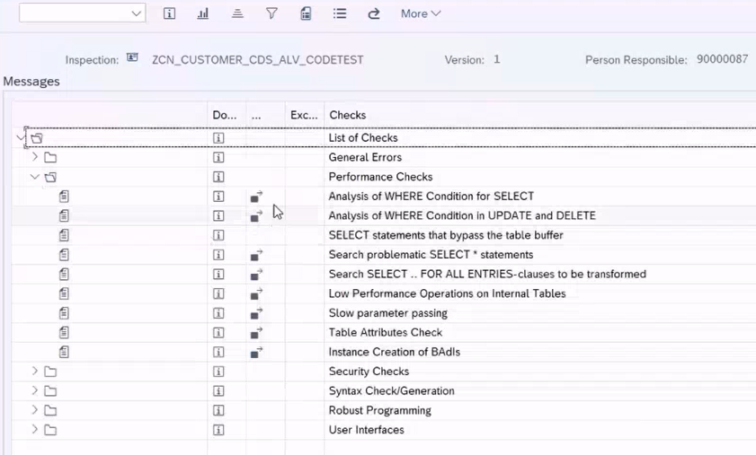
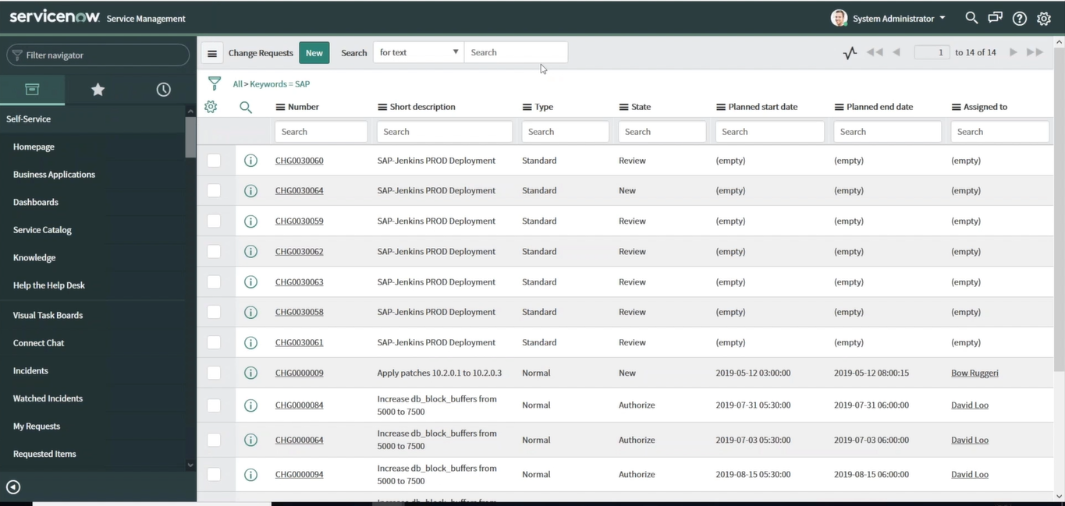
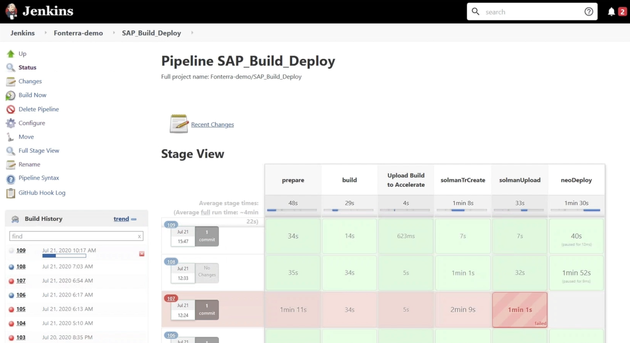
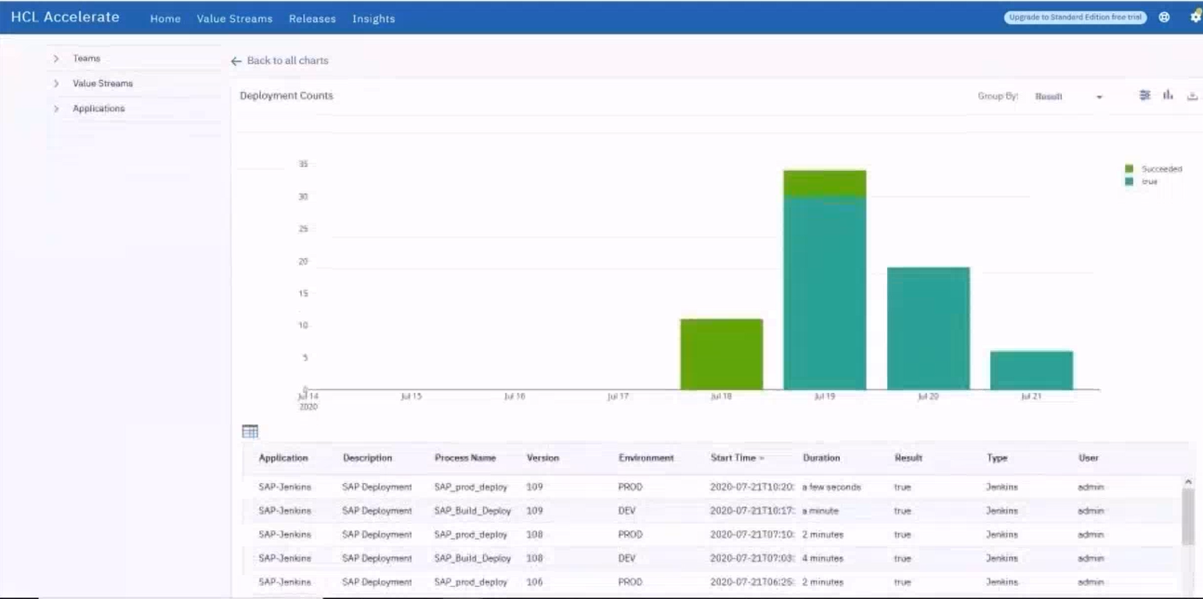
DevOps - Delivery
DevOps Lifecycle
<< Continuous Improvement <<
Plan &
Setup
DEV
- Higher
Quality
QA
- Efficient
Testing
PREPROD
- Regression & Assurance
PROD
- Minimise
Impacts
Approval &
Automation
Approval &
Automation
Approval &
Automation
Monitor &
Operate
Improve /
Retire
Request &
Approval
>> Continuous Integration >>
>> Continuous Testing >>
>> Continuous Deploy >>
>> Continuous Delivery >>
Plan Dev Test Done
Dev Qa PreP Prod
Task 1
Team 1
Task 2
Team 2
Task n
Team n
Deployment Status to show Tasks status
Overview by project of Backlog
Overview across projects/requests to show status
Release plan to show versions by environment
Agreed release plan/sequence & Rapid frequent deployments
Planned in patches/upgrades
Requests
Agile Dev
Code Control
Test Automation
QA & Security
Deployment Automation
Monitoring
More Rapid deployment cycles, via agile delivery, designed resilience and Automated testing/deployment
Notes:
Seema would combine responses post inputs with Abhijit

Slide 11
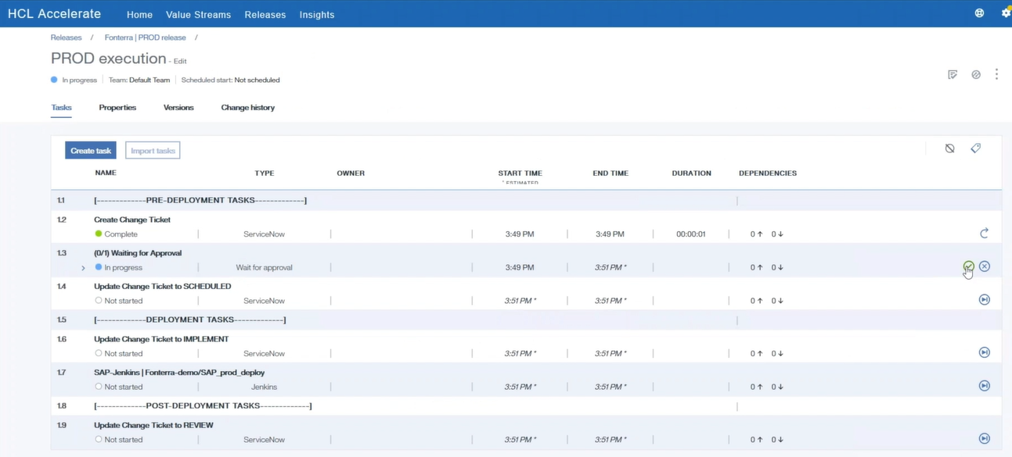

DevOps – Management & Visibility of Delivery
HCL Accelerate & Deploy
Backlog visibility
All workitem status
Deployment tasks
Approval controls
Component version across Dev, Qa, Prod etc
Deployment tracking and Status
SAP Environment tools
Hybrid Environment tools
Solution Manager
Focus Build
Agile Project Management (i.e. Jira).
Code repository (i.e. GitHub)
Ticket Management (i.e. SNOW)
Development & Deployment (i.e. Jenkins)
Best practices
Documentation
Charm/Transports
Change Requests
Work Packages/Items
Development Mngmnt
Supporting SAP & non-SAP DevOps items
AppScan (for Security), Test Automation (Aunit/Junit, Functional Tests), Code Checks (standards, performance) ….

Slide 12







Example - Hybrid SAP and Non-SAP DevOps Delivery
TARGET
SYSTEM
Create Work Package &
Work Items
Jira User Stories
SAP Fiori UI Code Repo
Jenkins
Value Stream Mgmt.
Portfolio View
Release Mgmt.
HCL Accelerate
Release
Velocity
Non-SAP
Cloud App
Release
HCL Launch
SAP ABAP
DEV Backend
SAP ABAP
PROD Backend

Slide 14
DevOps – Demonstrations & Scope
DevOps - SAP as a core component
Objectives & Scope
Show DevOps within the context of the main SAP toolchains
Requirement to Deploy
Detect to Correct
Cover how other toolchains (DevOps styles) can also be utilised
Highlight areas of significant change/difference to classical SAP delivery teams
Highlight lessons learnt from recent (SAP Focused) projects: Fonterra, Lego, BBC, etc
Provide supporting presentation & recorded demo
Later phase of demos will cover (Ideate to Launch & Run to Optimise)
DevOps – Other Demonstrations
Key Features
Demonstrations
For Customers with:
Full SAP solution (with SolMan Focus)
Mixed SAP and Non-SAP hybrid (Multi-product focus)
Application Management Support
Cloud First
Sapphire 2019 Demo
UrbanCode Demo
DryICE Demo
Cloud Native Labs Demo

Slide 15

Cloud Portal & Cloud Platform Delivery
Development options
“Customers often focus only on Open or Abap”

Slide 16
Example SCP Example Tool Chain
Continuous Business Processing
SAP SolMan 7.2
JIRA/Confluence
Code Quality
SAP Custom Code Management
SAP Abap Test Cockpit
ShiftLeft Dev Enforcer
ShiftLeft Unit Test Automation
Continuous Business Planning
Code Quality
Build Automation
Deployment Automation
Test Automation
CI / CD
Provisioning
Agile Development
Collaboration
Deployment Governance
Operational Monitoring
Training
Tools
People
Process
Operational & Process Monitoring
SAP SolMan7.2
SAP Central Processing Scheduling – Redwood
DevAnalytics
CI & CD
Integrate with JIRA/Confluence
Transport Expresso
ShiftLeft Risk Guard
Build Automation and refresh
SAP LVM/ TDMS
Cloud Provisioning Solutions
Deployment Governance
Transport Expresso
SAP CHaRM & QGM
DevMax Release Build List
Deployment automation
Transport Expresso
DevMax for Dual landscape
Test automation
Aunit/Junit
HCL OneTest
SAP SolMan
WorkSoft
Tricentis Tosca
Testify
HP ALM
Collaboration
Transport Expresso
Integrate with JIRA/Confluence
Training
HCL Lucy
SAP Enable Now
Others…
Agile Development
Integrate with JIRA
Integrate with Confluence
Integrate with HCL UrbanCode
Provisioning
SAP LVM
SAP IT Infrastructure Management
Cloud Native Toolsets

Slide 17
SCP – Agile Delivery methodology
Features
Business confirm requirement/justification (from Gap/Fit, Business Case, Reflection or Innovation session) , adding to a backlog)
Effort solutions estimated at a high level and Minimum Viable Product (MVP) identified, with design thinking & ideaification
Reviewed by Design Authority for potential inclusion in overall solution (Story/Epic) and specific sprint (for iTribe or wider Guild Team)
Item placed on a build list – Prioritised by Business Owner, detailed input by Sprint Team
Agile development (Using tools such as; whiteboard, Excel templates, Focus Build, Jira or other ‘Agile tools’)
Developments “Side by Side” or via approved ‘in-app’ options (confirmed by Design Authority)
Developments still formal (spec, coding, testing, although iterative) , more automation of Testing / Deployment, less Abap (Java, tools , annotation)
Code management, deployment and running to the confirm overall platform (i.e. SCP, Azure, AWS) and code control (i.e. Github)
UI’s mostly browser based (users, support/admin may be SAP Gui), UI5/Fiori, thus taken into account within development
Agile Project
Delivery
Backlog
Solution Validation
Priority
25
16
18
20
Epic
Tests
Final Prep
Demo
MoSCoW
04
03
02
01
[d]
Epic
String
String
Support
Monthly update
DevOps
Pre-built system / Best Practice
Sprints 1-3
Sprints 4-6
Delta
Design
Organizational
Readiness
Release Planning
Iterations / Demos
Prepare
Explore
Realize
Deploy
Run
DevOps
Delivery
Periodic DevOps Cycles – Supporting Knowledge repository, learnings and best practices
Continuous Integration & Dev
Backlog
Epic
Tests & Automate
Final Prep
Monitor & Measure (KPIs)
Priority
25
16
18
20
String
DevOps Planner
MoSCoW
04
03
02
01
[d]
Sprint (s)
Alerts, Logs & Analysis
Automation (Deploy& Operate)
Organizational
Readiness
Automation & Optimisation
Design thinking & Reviews
Iterations / Demos
Code & Version Management
Assess & Innovate
Release Planning
Defect & Change Management
Plan & Set-up
Develop and Test
Deliver
Monitor & Operate

Slide 18
DevOps - Operating Model
Today
DevOps Age
Integrated Stack
User Personas
OTC
PTP
DTS
Finance
Customer
Service Desk
L1, L2
Service Desk
L1
Automation
Service Operations
L3
Engineering “DevOps”
Agile
Capability
Model
Engineering - RUN
L4
Engineering - GROW
Consult
Consult
Transform
Consult
Transform

Slide 19
Change and Release Management
CHANGE
PREMIUM CARE
CONTINUOUS RELEASE TRAIN
Features
Discretion-ary
Technical
Debt
Service Requests
Break Fix
Minor
Enhance.
Release 1
Release 2
Release 3
Release 4
Release N
Product Backlog
Product Team 1
Product Team 2
Product Team nn
Product
Mgmt.
Solution
Arch.
Product
Mgmt.
Solution
Arch.
Product
Mgmt.
Solution
Arch.
P1
P4
P2
Team # 1
Team # 2
Team # 3
P3
Team
Backlog
• • •
Governance
Triage & Support
QA
Infra/DBA
Security
Enabler Backlog

Slide 20












SAP – Example Operational Scope
Development
Governance
Quality Assurance
Agile Development & Continuos Integration (CI), single code managemnt
Revert back to standard, clean core
How - Scaled Agile & Agile, HanaSmart, Activate & Focus Build. Simplification list, SAP Extensibility, Side by Side Dev.
Setup Rules to request SAP Instances / Copies in line with Formal Requests
Ensure Sign off for each stage of commissioning an SAP Instance
How - IT Ops tools (Snow, Remedy) & SolMan/Charm
Automated testing, zero defect pass on
All pre-testing tasks, clean-ups, post-testing tasks, etc. are automated and aligned with the CI cycle
How – Aunit, Junit, Func Tests (One Test, ALM), SolMan Test Cases, ATC.
Non-Functional Req’s
Operation
Recovery
Always “right-size” the initial Footprint of ECC as you progress to S/4 & Cloud
Performance, scale & resilience
How – Cloud based design, de-coupled design, Rest based API use.
Continuous Deployment, Automated Ops
Backups & Restores aligned with other SAP Component & SaaS solutions/SLAs
How - Life cycle Tools integrated to CI with strong configuration management, zero touch release to production
On Premise S/4HANA and Subscription based SAP Systems , e.g Success Factors follow different release & patch cycles, ensure RTO & RPO is agreed
How - IT Ops tools (Snow, Remedy) & SolMan/Charm
Release Planning
Monitoring/Alerting
Provisioning
Single route to production, with known release cadence with patches/upgrades
Co-ordinated demand/release plan
How – ChaRM, SolMan, CTS & CTS+
Automated monitoring and alerting
SLA/KPI’s to support processes, tasks and operations
Dashboards & summary information
How – SolMan, Focus Run
Managed provisioning of services, capacity, users and access.
Estimation and service planning
How – Updated scoping & estimating, global and sub-account planning and reviews
Procedures/Frameworks
Methodology/Standards
Architecture
Agreed common procedures & WoW
Re-usable components, central config management & business rules.
How – Cloud Strategy, development standards, architectural patterns, delivery frameworks.
Continuous Deployment
Backups & Restores aligned with other SAP Component & SaaS solutions/SLAs
How - Life cycle Tools integrated to CI with strong configuration management, zero touch release to production
Agreed architectural vision and strategy
Core principles and only necessary governance
How – IT strategy and policies, Design Authority and Governance

Slide 21
Development – Core Principles when adopting Agile & DevOps
Culture
Shared Ownership
Collaboration
Automation
Business Success Measures/Performance
Customer/User Experience
Sharing
Overlapping skills & knowledge
Measurement
Continuous Integration
Innovative
Continuous Deployment
Automated Testing & Deployment
Flexible Landscape
Repeatable Processes & Automated Operations
User Adoption
Speed & Quality of Development
Application Performance
Empowering Teams & Individuals
Issue resolution
Quality feedback loop
Input into design & delivery
Agile, Flexible and rapid delivery

Slide 22

Typical Agile Delivery Phases

Slide 23




Typical initial DevOps Used in core SAP delivery: Solution Manager , Focus Build & Open Tools
Solution Manager
Focus Build
Open Tools
SAP Solution Manager is the key SAP module to deliver SAP Best practices and integrate any customer specific adjustment through the Charm transport management component.
SAP Focus Build is used to capture the requirement traceability metrics between from SAP solution Best Practices, to the fit/gap and to the final solution build, test and validation.
It also offers some Project Governance tools.
Open Tools - provides a complete framework for project management and agile delivery. It includes all the functionalities to manage the high-level project plan as well as the agile execution from the roadmap to EPICs down to user stories. With its best in class out of the box agile toolset (Scrum Board, burndown report, etc.), it enables an effective collaboration for virtual teams of any size.

Slide 24
DevOps Framework Summary
Release Management
Environment Management (provisioning automation)
Deployment Automation (Configuration, code, patches, upgrades)
Collaborative Development
Configuration Management
Build Management
RELEASE
CODE
DEPLOY
PLAN
Capture, Analyze & Prioritize Business Requirements
Project Planning
Measure Project and Process Metrics
Traceability
Dashboard portfolio measures
Dev
CONTINUOUS TESTING
Ops
OPERATE
BUILD
MONITOR
Release Planning
Change Management
Dashboards
Traceability
Monitor Capacity and Optimize
Monitor Performance and Optimize
Monitor User Experience and Optimize
Event and Incident Management

Slide 25
Design Thinking
Formulate Value Hypothesis
Generate New Ideas & Evolve
Frame Opportunities
Pivot or
Persevere
Abstract Concept
discover
Prioritize
learn
Form
Insights
Actual Build
Experiment
Research & Observe
deliver & deploy
measure XM
Concrete Direction
discover
iterate
Revise Hypothesis
design
Identify Need
Gather Feedback
Pain Point
Resolution
Explore with empathy towards the customer/user
Lean design to focus on the right things
Agile & DevOps execution to build the things right

Slide 26


Cloud Native Overview - SAP Cloud Platform
Typical System Set-up
SCP System Landscape
Dev & Quality system can be morphed one system referred to as “Q” (reality is often clients still retain Dev, QA, Pre-Prod and Live).
Production System, referred to as “P”
Transports need alignment with any backend SAP releases
Utlise CTS+ for transports
Utilise SolMan for Change/Release Management
Upgrades tested on Q prior to implementation on P
Account Set-up
Global account set up by SAP with agree entitlements (services)
Cloud Foundry (open/java and SAP’s expected direct), Neo (Abap focus)
Client SCP Admin allocates to sub-accounts plus granting , quotas on space & memory, then monitor use/consumption
Projects/Packages used to manage items within a sub-account, within Organisation/Space areas.
GitHub (of similar) for code management & part of wider toolchain

Slide 27

Cloud Native Delivery - Design Thinking & Agile Delivery
Challenge ways of working & empower teams for new delivery options
Business Models
End-to-End Processes
Strategic
Roles
User focus
Process dis-covery
Insights & Designs
Innovation, Automation & Deliver
Feedback & analysis
Design Methods, use a range of methods
Process Driven - Explore known challenges starting with processes, historical data & technology (core focus area)
Design Driven - Re-imagine & innovate- uncover unmet needs of people, look to the future, find human meaning for technology
People Driven - Persons Experience & Enterprise Processes Design.
Design Thinking & Design Doing - Ensure solutions embrace the new, but also get delivered.
User
Product
Owner
Scrum
Master
Process
Expert
UX
Tech
Team
Test Team
Design Approach, know the problem & design the solution
Understand - Requirements, Process, People & Solution options.
Design – Iterate through with key ideas and direction & refine.
Deliver – Use Agile / DevOps methods in iterative delivery
Value – Delivery speed & innovation, build future capability & ROI
Resource Enablement, across the team to ensure
Awareness – of design thinking & cloud methods
Training – build formal skills and knowledge
Try – use knowledge in pilots or early first projects
Apply – use in projects, App Tx or SAP extensions
27

Slide 28
Cloud Native Delivery - SCRUM Methodology
Leading an Agile Approach
Agile Project Delivery
Daily Scrum
Sprint Review Meeting
Sprint Execution
Scrum Process
Recurring Cycle
Sprint Retrospective
Sprint Backlog
Sprint Planning Meeting
Scope
Product Backlog
Usable Software
Design
Notes:
Remove or move to a higher level

Slide 29

Cloud Native Delivery - Example phase and deliverables
Agile in wider project
Prepare
Explore
Realize
Deploy
Run
Best Practices that fit customer scope
Solution Scope and Value Determination
Delta Design
Release and Sprint Plan
Sprint Execution
Value Management
Support after Go-Live
Prioritize Backlog
Integration Testing
Cutover
Application Lifecycle Management
Initial Roadmap and Approach
Solution Validation including Gap Validation**
Organizational and Production Readiness
Value Audits
Operations Control Center
Pre- Assembly
Baseline Build
Technical and System testing
Setup Operations or OCC**
Jump-start project with pre-assembled solution
Identify & validate delta requirements and gaps
Build customer solution in short, time-boxed sprints

Slide 30







Example development process – “End to End” overview for PoC
HCL SCP – Delivery Methods
Scope Item
… Dev
… Visualise , Test & reflection
Idea
Fit to Standard, Extension, full cloud, RestAPi, Innovation, RAP etc
Mock up
Assess
Justification, business case, benefit, opportunities
Design/pilot ( mock up , confirm core Story/Epics, Persona’s)
Methodology (Agile), Strategy (CN)
Tools for design (Focus Build, Jira)
Delivery location , SCP, WebIDE other Cloud Platform/Tools
Design
Review
Reflections, Retrospectives and Reviews of design (and through delivery iterations)
Pilot
Establish a Team (Ci/cd, DevOps, Project?)
Build up Stories/Epic
Define Sprints and duration
Focus on core solution, Minimal Viable Product
Build in automated tests
Manage how more frequent deployments are supported
Include CN strategic best practices (12+3 factors, i.e central log)
Operate the Solution and start CI/CD
Pilot
Build MVP
MVP
Deploy
Ci/cd – to maintain, develop , extend the solution
Enable small team to continue work
Enable others to use more open (back office) APIs
Give Platform and architectural freedom to teams
Engage with the business and end user, gain insights into use/needs
Extend
Extend

Slide 31








Example development process – Step 1 Requirements & Scope
Cloud Native Delivery – Hands on Development
Scope Item
Details
Accelerator
Outline the user story (“As a ….”, “I want to….”, “So that I can….”
Possible Theme, Epics
Possible Services and solutions considered
Business use and benefits
User Story
Who the solution is aimed at
There needs, drivers, requirements
Persona
Initial design options, approach, strategy, tool use, use of Cloud Platform and main solution options.
Build mock up to gain early input and visualisation
Design
High level plan, resourcing, backlog, view on iterations, roadmap.
Plan
“We will jointly workshop these four points shortly”

Slide 32






Example process – Step 2 Early PoC Building
Cloud Native Kickstarter – Hands on Development
Scope Item
Details
Accelerator
Review requirements to available Solutions (Apps), components, services, templates and/or Accelerators
Gap/Fit
Assess approach to Data such as Accessing backend data, managing any cloud data, domain focus impacts from design
Data
Build initial iteration of App (service/solution) or key parts to gain initial input, more in-depth understanding and prove initial capability
App
Get feedback on solution, design, development process, agile delivery
Feedback

Slide 33













Walk through of an SCP Development – Agile Dev
User Story, what’s required and roles
Ux Journey
Persona
Story map (multi Apps into an ‘Epic’)
Plan Backlog & burn down
Story Journey and RoadMap
Build mock-up/wire frame
Scrum Board
SAP Solution Manager “SolMan”
(or Focus Run with wider SCP use)
(processes, docs, PM/Proj Mngmnt
Installs, upgrades, landscape etc)
Best Practice info in SolMan
& fully build SAP system with
Data and working processes
& Fiori front end and apps
Focus build is SAP tool,
For formal doc of all above
steps
Other Tools – i.e Jira (agile and defects)
33

Slide 34
Example Sprint
Two Week Sprint Example Plan
Week 1
Week 2
Mon
Tue
Wed
Thu
Fri
Mon
Tue
Wed
Thu
Fri
Sprint 1
Sprint 2
Kick Off
Daily Scrum
Daily Scrum
Daily Scrum
Daily Scrum
Daily Scrum
Daily Scrum
Daily Scrum
Daily Scrum
Daily Scrum
Sprint 1 Start
Mock up
Data/IFs
Std Func’s
Build Starts
MVP Focus
Build Units
Std Setup
Test Units
Continue Bld
Start linking
Build UI
Build Logic
Test core stories for Sprint 1
Sprint 2 Start
+ Backlog
Final MVP
E2E Story
Build & Extend
Build Units
Test Units
Build Units
Test Units
Test E2E
Finalise Bld
Review Backog
Close out tasks and Build, Lasts Tests
Scope
Design
Plan
Stories
Tasks
Backlog
Teams
Run / Demo core stories for Sprint 1
Demo & Review
Daily Update
Daily Update
Daily Update
Daily Update
Daily Update
Daily Update
Daily Update
Daily Update
Cross team tasks
Cross team tasks
Cross team tasks
Sprint Reflection
Cross team tasks
Cross team tasks
Cross team tasks
Sprint Reflection
Meetings
Delivery time

Slide 35



Example Roles
Team (allocate named people to these roles)
Acts as Product Owner responsible for over all requirement and acceptance of solution
Acts as Scrum Master (s) responsible for consistent scrum execution and standards
Management
Confirm: Scope, Plan, Success Criteria & manage delivery
Requirement
Plan
Delivery
Acceptance
Scope
Epic/Stories
Design
Backlog
SME/Specialists
Agile
Cloud Native
SCP & SAP
Client Work Stream SAP, SCP & Cloud
Specialists
Functional / Testing
Epics/Stories
Features
Func Design agreement
Acceptance criteria
Cloud , SCP & UI
Agree Mockup
Agree UI Design
Agree Tech Design
Understand methods & tools
Data / Interfaces
Data Requirements
Agree Data & Interface use
Understand methods & tools
HCL Work Stream SAP, SCP & Cloud
Specialists
Func Design
SAP interaction
Test Cases
Issue resolution
Tech Design
UI design/Build
Tech Tests
Co-ord E2E build and issue resolution
Data I/F Design
IF Build
IF Tests
Connectivity & Microservices
Volume Delivery
Extend day working
Repetitive or low interest/value tasks

Slide 36

Stories/Tasks in Jira Note SAP SolMan’s & FocusBuild can have an equivalent
Start off Jointly then break into sub-teams (Pairs)
Afternoon “update“ to confirm progress but chance for issue escalation, also joined up tasks/testing at the end of each day

Slide 37




Transitioning SAP estates to Cloud and DevOps ready solutions
Current State
Realisation Considerations
Multiple platforms & systems
Simplified landscape – simplify and reduced TCO
Heavily modified for business use
Leverage best of breed – Use the best & right solution
Challenging to change or upgrade
Redeployment – Leverage existing IP and differentiation.
Large volume and range of applications
Architectural simplification – Open & Cloud Native delivery
Tightly coupled landscape & systems
Reduced code – less code & modification (higher configuration)
High costs and high % spent on support
Innovation & Automation – Using it today without upgrading.
Long lead times on changes or corrections
Differentiation – Know when to standardise & when to differentiate
Target State
Compelling business case & ROI
Simplified core – standardised whenever possible.
De-coupled extensions – utilising cloud native delivery options
Resilience – Designed in error & exception handling
Simple governance – Higher automation, DevOps style delivery
Architectural alignment – Managed across time & domains
Transition – During upgrades or in years before/after, as required
Richer User experience & intelligence
Innovation agility to differentiate & lead.
On-demand & OPEX cloud cost control
Simpler & frequent updates for IT health
Agile delivery & design thinking for solutions
HCL Delivery Tools & Services
Open solutions to avoid vendor specific lock in
HANASmart
Blu-Thinking
Business & Market Drivers

